Slide 1
2.1
Classes and Objects

Slide 2
Classes and Objects
CLASS | OBJECT (aka INSTANCE)
A class is a blueprint from which you can create the instance, i.e., objects. | An object is the instance of the class, which helps programmers to use variables and methods from inside the class.
Classes have logical existence. | Objects have a physical existence.
A class doesn't take any memory spaces when a programmer creates one. (The “idea” of a cat) | An object takes memory when a programmer creates one. (A real, live cat)
The class has to be declared only once. (i.e. “Cat”) | Objects can be declared several times depending on the requirement. (i.e. “Buttons”, “Mr. Bigglesworth”, “Garfield”)

Slide 3
Class
Object
String
String greeting = “Hello world!”;
String favoriteClass = “AP Computer Science”;
String bestTeacher = “Ms. Molina”;
Notes:
Car Example
4 Door Sedan -> Three different instances of that sedan

Slide 4
Attributes (instance variable) and Behaviors (methods)
An attribute or instance variable is data the object knows about itself. For example a turtle object knows the direction it is facing or its color.
A behavior or method is something that an object can do. For example a turtle object can go forward 100 pixels.

Slide 5
2.2
Constructors

Slide 6
Dog
public class Dog {
private String breed;
private int age;
private String color;
public Dog() {
breed = “pug”;
age = 3;
color = “brown”;
}
public Dog(String a, int b, String c) {
breed = a;
age = b;
color = c;
}
}
Default constructor
An overloaded constructor that takes parameters

Slide 7
World world1 = new World(); // creates a 640x480 world
World world2 = new World(300,400); // creates a 300x400 world
Turtle t1 = new Turtle(world1);
Turtle t2 = new Turtle(50, 100, world1);
Notice here that the order of parameters matters

Slide 8
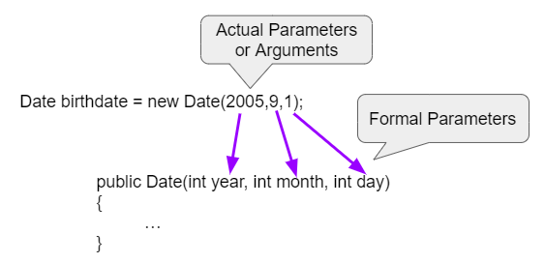
Formal and Actual Parameters
Date(2005,9,1) - This is call by value which means that copies of the actual parameter values are passed to the constructor. These values are used to initialize the object’s attributes.

Slide 9
2.3
Methods

Slide 10
What is a method?
A method is an action defined for a class that all instances of that class (objects) will support.
Methods can:
Provide access to an attribute of an instance
Update an attribute of an instance
Do something new and interesting with the information stored in an instance
Methods are called using the "." operator, which allows access to the public methods of a class.

Slide 11
An example… what number is printed?
// Dog.java public class Dog {
private int age; // an attribute
public Dog(int dogAge) { // constructor
age = dogAge;
}
// a method that updates an attribute.
// returns nothing
public void makeOlder(int years) {
age += years;
}
private int dogYears() { // an internal method
return 7*age;
}
// a method that retrieves an attribute
public int getAge() {
return dogYears();
}
}
// TestDog.java
public class TestDog {
public static void main(String[] args) {
Dog goodBoy = new Dog(5);
goodBoy.makeOlder(2); int age = goodBoy.getAge();
System.out.println(age);
}
}

Slide 12
Method declarations
Method declarations, such as public void makeOlder(int years) { … }
Define whether the method is accessible to the outside world (public / private)
Public methods are available externally (e.g. goodBoy.getAge()) while private methods are not (calling goodBoy.dogYears() in main will cause an error)
Determine what the method returns
Void methods return nothing
String methods promise to return Strings, int methods to return ints
Defines the variables (parameters) passed to the method
To be described in the next section
Define the body of the method
The body is the statements of code that will execute when the method is called.

Slide 13
Abstraction – keeping things simple
One of the core concepts in computer science is abstraction. Abstraction means that you only need to understand how to interact with an object–you don’t need to understand how the code is actually implemented behinds the scenes.
E.g. as a user, I should be indifferent between the following implementations:
Option 1
private int dogYears() {
return 7*age;
}
public int getAge() { return dogYears();
}
Option 2
public int getAge() {
return (age + age + age + age + age + age + age);
}
Option 3
public int getAge() {
return 7*age;
}

Slide 14
The power of abstraction
Abstraction accomplishes two things:
It keeps things simple, minimizing what you need to know to write a program
It makes it possible for the class owner to change the technical implementation of the method without impacting its use
e.g., option 3 may be faster for a computer to calculate than option 2… the programmer may want to switch their implementation from 2 to 3. Abstraction means that the user won’t notice a difference (besides faster code)

Slide 15

NullPointerException
A variable Dog dog; points to an instance of class Dog.
It starts out not pointing to any Dog, with the special value null.
You have to use new Dog to construct a Dog instance that the variable can point to.
If you don’t initialize a variable to point to a Dog instance, and you try to call a method, NullPointerException will be thrown.
Dog badDog; // badDog == null badDog.getAge(); // throws NullPointerException
Dog goodDog = new Dog(3); // goodDog points to instance goodDog.getAge(); // no problem
badDog variable
null
goodDog variable
Dog instance
age
3

Slide 16
Instance and static methods
Instance methods act upon instances of a class. We first create an instance and then call on one of its instance methods.
String t = "blue”;
t.substring(0,2); // "bl”
Static methods aren’t bound to a particular instance of a class. They are called by naming a class following by the dot operator:
String.valueOf(1234); // "1234”
So what does public static void mean?

Slide 17
2.4
Method Parameters

Slide 18
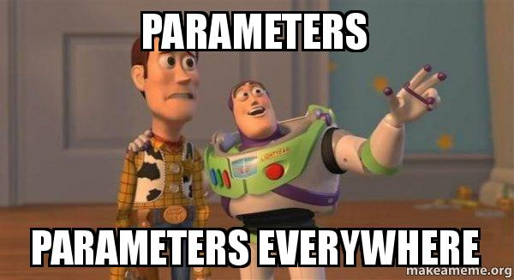
Use parameters!
// Person.java
public class Person {
private String name;
public Person(String personName) {
name = personName;
}
// Greeting
public void greet() {
System.out.println(name + " says: Hello, world!");
}
// Greet a particular person
public void greet(String otherName) {
System.out.println(name + " says: Hello, " + otherName + "!”);
} }

Slide 19
Calling methods with parameters
// TestPerson.java
public class TestPerson {
public static void main(String[] args) {
Person amy = new Person("Amy");
amy.greet("Ted"); // Prints "Amy says: Hello, Ted!"
amy.greet("Thursday"); // Prints "Amy says: Hello, Thursday!"
Person bob = new Person("Bob");
bob.greet("Amy"); // Prints "Bob says: Hello, Amy!"
}
}

Slide 20
Definitions
Formal Parameter (parameter) -The variable declared in the method header
public void greet(String name)
Actual Parameter (argument) - The value passed in a method call
amy.greet("Ted");

Slide 21
Method Overloading
Overloaded methods are two or more methods in the same class that have the same name but different parameters.
// Person.java
public class Person {
private String name;
public Person(String personName) {
name = personName;
}
// Greeting
public void greet() {
System.out.println(name + " says: Hello, world!");
}
// Greet a particular person
public void greet(String otherName) {
System.out.println(name + " says: Hello, " + otherName + "!”);
} // Greet a number
public void greet(int aNumber) {
System.out.println(name + " says: How are you, " + aNumber + "?");
}
}

Slide 22
Calling Overloaded Methods
// TestPerson.java
public class TestPerson {
public static void main(String[] args) {
Person amy = new Person("Amy”);
amy.greet(); // Prints "Amy says: Hello, world!”
amy.greet("Ted”); // Prints "Amy says: Hello, Ted!”
amy.greet(12); // Prints "Amy says: How are you, 12?”
}
}

Slide 23
2.5
Return Values

Slide 24
Return Value
Methods can take inputs (“arguments” or “parameters”), and they can also spit out a single output (“return value”)
public double distance2D(double x1, double y1, double x2, double y2)
x1
distance2D method
y1
return value
x2
y2
Methods are like functions… what is the difference between a function and a method?

Slide 25
Return Value
Methods that don’t return anything have a void return type
public void printGreeting(String name) { System.out.println("Hello " + name + "!"); }

Slide 26
Return Value
The type of the return value must match what is declared in the method declaration
Right: public int getNumberTimesThree(int value) { return 3 * value; }
Wrong (why?): public int getNumberTimesThree(int value) { return 3.0 * value; }
Q: Java only lets you return one value from a method. How might you return multiple pieces of data at once?

Slide 27
Getter and Setter Methods
In Java, you’ll commonly find that classes declare getXYZ and setXYZ methods for their properties (instance variables).
public class TurtleTestGetSet { public static void main(String[] args) { World world = new World(300,300); Turtle yertle = new Turtle(world); System.out.println("Yertle's width is: " + yertle.getWidth()); // Yertle's width is: 15 (this is the default width) yertle.setWidth(200); yertle.setHeight(200); System.out.println("Yertle's width is: " + yertle.getWidth()); // Yertle's width is: 200 (this is the width after we’ve set it to 200 2 lines above yertle.turnRight(); world.show(true); } }
This is considered a best practice. Q: Why do you think that is?

Slide 28
toString Methods
In Java, all objects can be represented in String form by defining a toString method.
This can be useful for programmers to get a visual or textual representation of an otherwise abstract object.
How can we make the toString method to the right more descriptive?
What gets printed if you don't define a toString method?
class Student { private String name; private int age;
Student(String name, int age) { this.name = name; this.age = age; } public String toString(){ return name; } } class HelloWorld { public static void main( String args[] ) { Student s = new Student("Jane",16); System.out.println(s.toString()); //”Jane” System.out.println(s); //Also ”Jane” } }

Slide 29
this is a reference to the current object instance
class Student { private String name; private int age;
Student(String name, int age) { this.name = name; this.age = age; } public String toString(){ return name; } } class HelloWorld { public static void main( String args[] ) { Student s = new Student("Jane",16); System.out.println(s.toString()); //”Jane” System.out.println(s); //Also ”Jane” } }
Student s
Call Stack
VERY common
pattern.
"Jane"
name
s.toString()
16
age
this
Q: What's the difference here between name and this.name?
main(new String[]{})
args
new String[] {}
s
Q: What do you think the next thing on the call stack will be on top of main?

Slide 30
2.6
Strings

Slide 31
Strings
Strings in Java are instances of the java.lang.String class that hold sequences of characters (a, b, c, $, etc.)
String s = “Hello, world!”;
String instance
s
0 | 1 | 2 | 3 | 4 | 5 | 6 | 7 | 8 | 9 | 10 | 11 | 12
H | e | l | l | o | , |  | w | o | r | l | d | !

Slide 32
Creating Strings
String is a class, so you can construct them with the new operator.
String s = new String(“Hello, world!”);
Strings can also be constructed using string literals:
String s = “Hello, world!”;

Slide 33
String comparison in Java
In many other languages, like JavaScript and Python, you can use the == operator to compare strings for equality.
In Java, the == operator compares object references, not what’s in the referenced objects!
s1.equals(s2) is almost always what you want, not s1 == s2

Slide 34
String concatenation
Strings can be appended to each other to create a new string using the + or += operator. This is also called concatenation.
In the expression x + y, x and y are the operands and + is the operator.
If x or y is a String, the other operand will be converted to String. That’s why
System.out.println("Temp: " + 43 + " Frozen: " + false);
works. What does this print out?
System.out.println("Age: " + 1 + 2);

Slide 35
2.7
String Methods

Slide 36

String Methods
int length() method returns the number of characters in the string, including spaces and special characters like punctuation.
String substring(int from, int to) method returns a new string with the characters in the current string starting with the character at the from index and ending at the character before the to index (if the to index is specified, and if not specified it will contain the rest of the string).
Remember: In Java, we always start counting from 0

Slide 37
String Methods
int indexOf(String str) method searches for the string str in the current string and returns the index of the beginning of str in the current string or -1 if it isn’t found.
int compareTo(String other) returns a negative value if the current string is less than the other string alphabetically, 0 if they have the same characters in the same order, and a positive value if the current string is greater than the other string alphabetically.
boolean equals(String other) returns true when the characters in the current string are the same as the ones in the other string. This method is inherited from the Object class, but is overridden which means that the String class has its own version of that method.

Slide 38
null
If you declare a String variable without initializing it, its value is null.
String s; ← Will contain null
Just like any other class, if you invoke a method of null, like s.length() here, Java will throw a NullPointerException.
null has its uses. It can represent the absence of a thing. For example, some people don’t have a middle name: class Person(String firstName, String middleName, String lastName) {...} Person person = new Person(“John”, null, “Middlenameless”);

Slide 39
Mutable vs Immutable
Mutable: CAN CHANGE, Immutable: CANNOT CHANGE
Strings are immutable. Any methods that seems to change a string actually just creates a copy of it, and returns the new version as its return value. String str1 = "Hello!"; // Print str1 in lower case? Will str1 change? str1.toLowerCase(); System.out.println("In lowercase: " + str1);

Slide 40
Why are strings immutable?
Immutability is a powerful concept in Computer Science. It can make it easier to reason about what a program does.
When you pass a String to a method, since Strings are immutable, you know that the method cannot change your String behind your back!
s += ", world!"; is really the same as s = s + ", world";
(but is stylistically better)
Many modern programming languages have immutable strings, such as Python and JavaScript. Some chose to have mutable strings, like Ruby.

Slide 41
2.8
Wrapper Classes

Slide 42
Wrapper classes
Wrapper classes are used to store primitive types inside of ordinary Java classes. Integer is a Java class, while int is not.
Integer has a single attribute storing the value of the int used to create the instance.
Constructors:
Integer i = new Integer(4); Double d = new Double(2.718);
Getters:
int j = i.intValue(); double e = d.doubleValue();

Slide 43
Wrapper classes
A variable whose type is a wrapper class like Integer, like any other class, is a reference to an object instance, not an object instance itself.
Using a wrapper class instead of a primitive type means more memory accesses, which is slower, and more memory used.
Wrapper object instances are also called "boxed primitives" – see the box?
Integer i = new Integer(4);
int j = 3;
Integer instance
i
3
j
3

Slide 44
Wrapper classes exist for every primitive type
Every primitive type in Java has a corresponding wrapper class.
boolean | java.lang.Boolean
byte | java.lang.Byte
char | java.lang.Character
double | java.lang.Double
float | java.lang.Float
int | java.lang.Integer
long | java.lang.Long
short | java.lang.Short

Slide 45
Autoboxing and unboxing
Originally, Java programmers had to explicitly convert between primitive types and the equivalent wrapper objects.
In Java 1.5 (released 9/30/2004), autoboxing and unboxing were added.
Autoboxing:
Integer i = 4; is the same as Integer i = new Integer(4);
Unboxing:
int j = i; is the same as int j = i.intValue();

Slide 46
Wrapper classes are immutable
The wrapper classes are immutable, like String. Once you create an instance of Integer, you can't change the int inside it.
The wrapper classes have getter methods like intValue(), doubleValue(), booleanValue(), floatValue(), but no setter methods.
Integer i = 3;
i = 5; ← This is really creating a whole new Integer object instance, and reassigning the value of i.

Slide 47
Why even use wrapper classes?
They contain useful methods and attributes:
Integer.parseInt(string) converts a string representation of an integer into an int
Integer.MIN_VALUE and Integer.MAX_VALUE store the largest and smallest possible 32-bit integers your computer can store. These lower and upper bounds on all computable integers are very useful in algorithm development
Storing primitive types within classes enables us to use Java language constructs that can only be applied to classes…
More on this later with Arrays and Maps

Slide 48
2.9
Math Class

Slide 49

The Math Class
This class implements standard mathematical functions and constants.
Math has only static methods and attributes. It cannot be instantiated with the new operator… it has no public constructor!

Slide 50
The Math Class
You can prefix with Math. to access Math methods and attributes, or use static imports to bring some or all of Math into your code's default scope.
These two code samples are equivalent:
public class Main {
public static void main(String args[]) { System.out.println(Math.PI); System.out.println(Math.sqrt(9)); } }
import static java.lang.Math.*;
public class Main {
public static void main(String args[]) { System.out.println(PI); System.out.println(sqrt(9)); } }
Q: Why was no import statement required on the left?

Slide 51
Absolute Value
static int abs(int x) | Returns the absolute value of an int value
static double abs(double x) | Returns the absolute value of a double value
Remember from lesson 2.4:
Overloaded methods are two or more methods in the same class that have the same name but different parameters.

Slide 52
Power
static double pow(double base, double exp)
Returns base^{exp}.
Assumes base > 0, or base = 0 and exp > 0, or base < 0 and exp is an integer
(What happens if base < 0 and exp is not an integer? It returns NaN, which means "Not A Number." double can't represent imaginary numbers. Math.pow(-1, 0.5) is equivalent to Math.sqrt(-1), which also returns NaN since the answer is an imaginary number.)
P.S. Imaginary numbers can be represented in Java, but it's not built-in to the primitive data types or the standard library. You can use a third party library or write your own.

Slide 53

Square root
static double sqrt(double x)
Returns the positive square root of a double value.
(If x is negative, this will return NaN - Not A Number.)

Slide 54
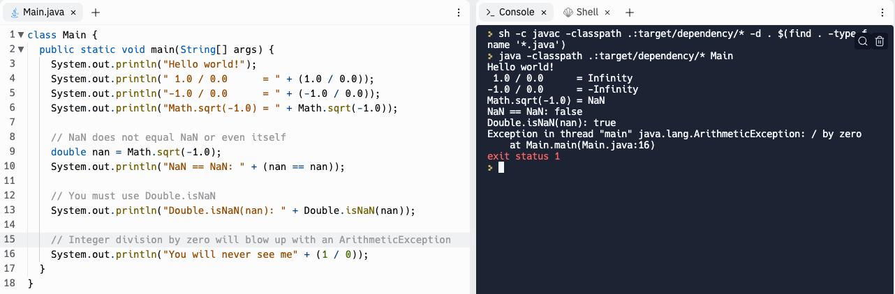
NaN: Not A Number (floats and doubles only)

Slide 55
Random number
static double random()
Returns a double value greater than or equal to 0.0 and less than 1.0
Example:
double randomValue = Math.random();
// Example output: 0.6573016382857277

Slide 56
Write code that generates a random int between 0 to 9
int random = (int) (Math.random() * 10);

Slide 57
Write code that generates a random int between 1 and 10
int random = (int) (Math.random() * 10) + 1;

Slide 58
Practice
Replit: "Adventure"

Slide 59
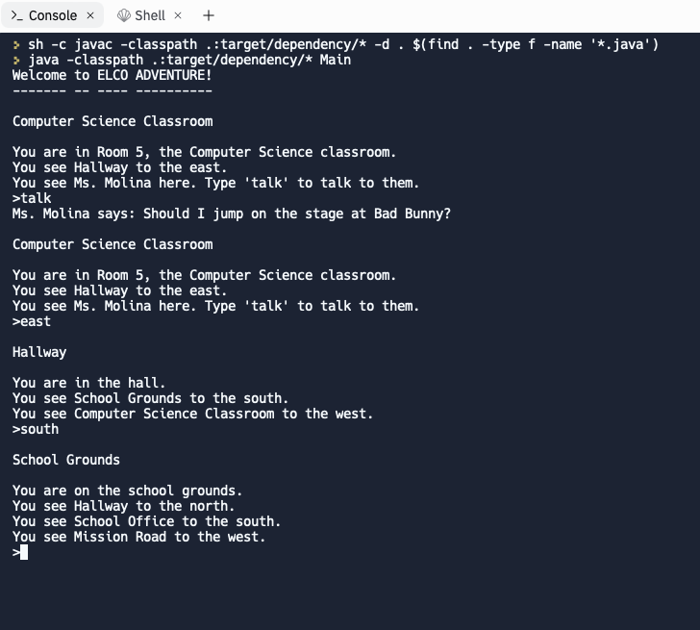

Slide 60
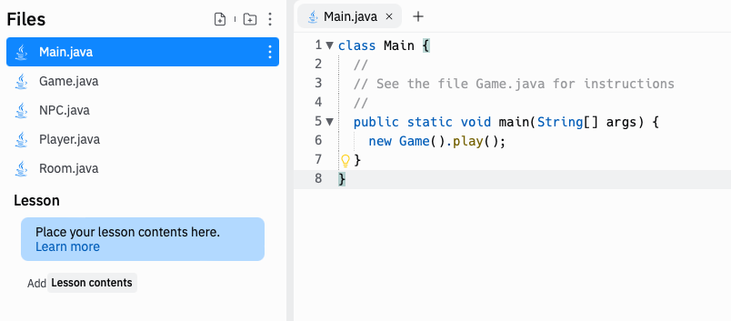

Slide 61
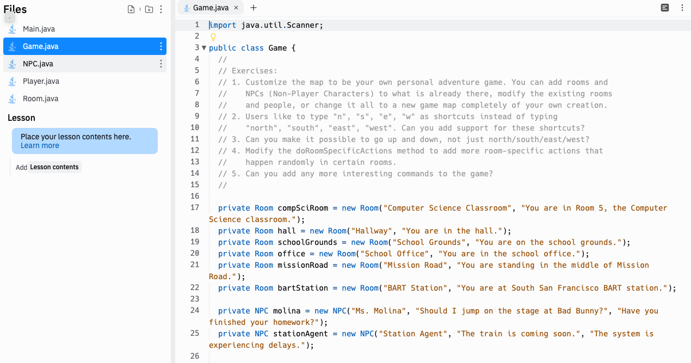

Slide 62
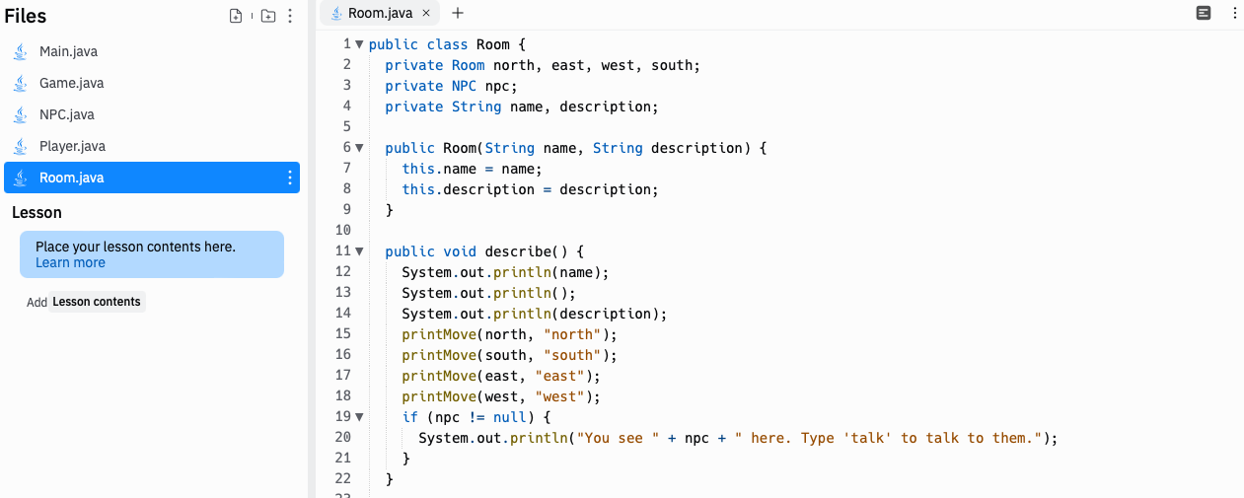

Slide 63
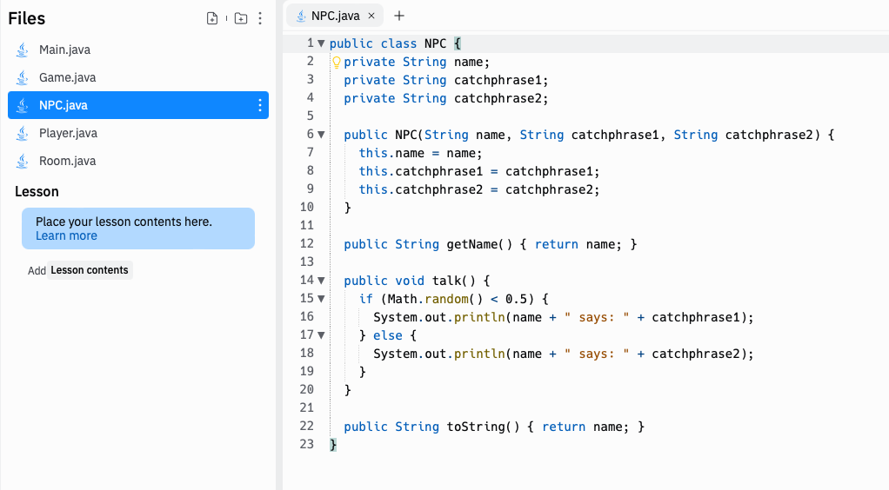

Slide 64
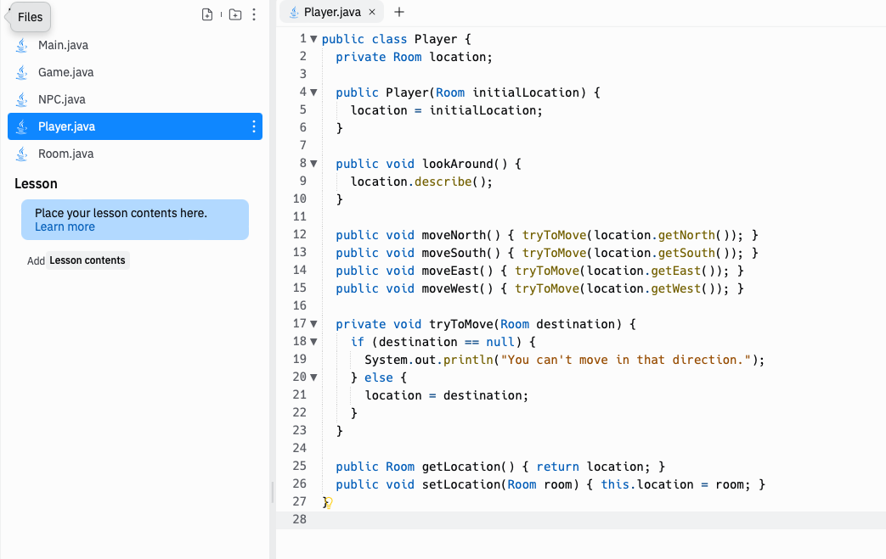

Slide 65
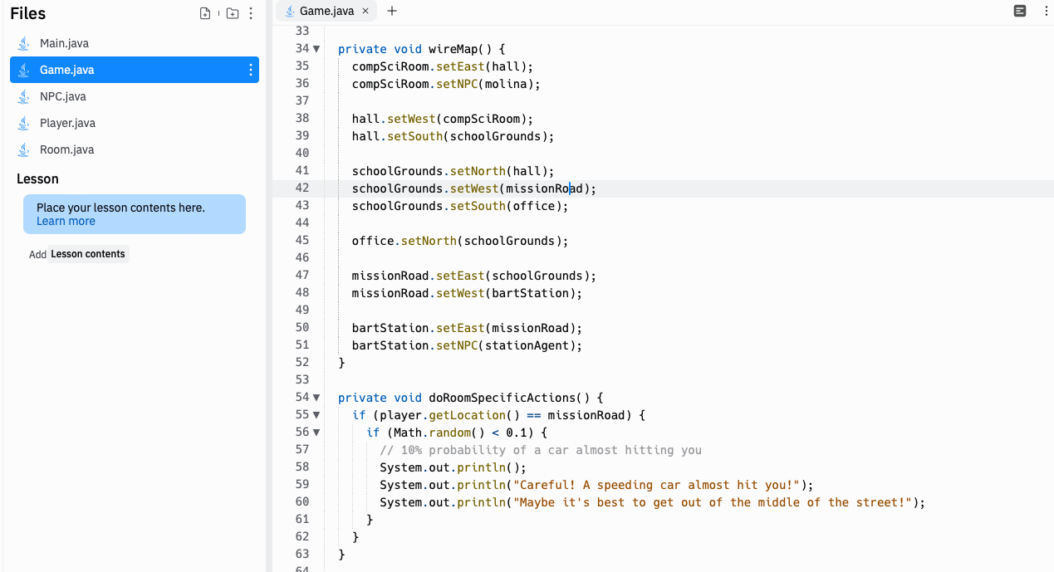

Slide 66
